Slide 1


NFC+: Breaking NFC Networking Limits
Renjie Zhao^{1,2,∗}
Purui Wang^{1,3}, Yunfei Ma¹, Pengyu Zhang¹, Hongqiang Harry Liu¹,
Xianshang Lin¹, Xinyu Zhang², Chenren Xu³, Ming Zhang¹
¹ Alibaba Group ² University of California San Diego ³ Peking University
*Personal page: renjiezhao.github.io
Notes:
NFC+: Breaking NFC Networking Limits

Slide 2











Transforming e-commerce into online-to-offline (O2O) commerce
Notes:
Today’s major internet companies are transforming traditional ecommerce into a new model that is called online-to-offline commerce.
Over the past few years, we have witnessed the great success of many companies following this transformation all over the world.
//Today’s major ecommerce companies like Alibaba and Amazon are transforming traditional commerce into a new model that is called online-to-offline commerce, the goal of which is to create a seamless shopping experience not only in the digital world but also in the physical world interacting with people.
At Alibaba, we offer a variety of new O2O services ranging from the same-day delivery fulfilled by**** Alibaba’s Cainiao logistics to improve shopping at Taobao and Tmall, and**** new retail shopping at Hema fresh which delivers fresh grocery to customer’s home within just 30minites, to ****local life services like Eleme which offers food-delivery for more than 2million restaurants with daily active users exceeding 260million people.
****We also see the corresponding companies which achieve great success.
//At Alibaba, we realize that simply offering click-and-collect on the web is no longer enough to satisfy customer expectations. Our customers always want more so at Alibaba,

Slide 3




O2O commerce is booming
Online proportion in 2019
COVID-19 changes the life style
Notes:
And we know that the booming of O2O is just about to start. ****Let’s take a look at the chart shown above. We can see that today’s online sale is just 10- 20 percent of the whole online and offline combined together,. So there is a trillion dollar opportunity and the O2O trend will continue to grow rapidly to close this gap.
****More importantly, this year, the COVID-19 pandemic may completely change the life style of people on earth. ****Now many people like me totally rely on O2O grocery and food delivery for living. So, we expect these changes to further accelerate the growth of the online-to-offline services offered by major Internet companies.
is very important since it occupies large proportion of total business. As the data from statista shows,
The offline retail sales accounted for 86% of all retail sales worldwide
In China, 79% or total retail sales offline.
While in U.S., only 90% is made offline.
There is still large room for offline business to online emerging.
This year, the COVID-19 pandemic change the life style a lot. More and more people choose to use grocery delivery or food delivery for daily life.
https://www.statista.com/statistics/1129915/china-ecommerce-share-of-retail-sales/
https://www.statista.com/statistics/534123/e-commerce-share-of-retail-sales-worldwide/
https://www.statista.com/chart/14011/e-commerce-share-of-total-retail-sales/
https://www.statista.com/statistics/187439/share-of-e-commerce-sales-in-total-us-retail-sales-in-2010/
https://www.emarketer.com/content/global-ecommerce-2019
https://www.digitalcommerce360.com/article/global-ecommerce-sales/
https://www.digitalcommerce360.com/article/e-commerce-sales-retail-sales-ten-year-review/

Slide 4



Core problem: object identification？
Notes:
As one of the largest O2O companies in the world, ****Alibaba group owns many subsidiaries such as Cainiao, Hema and Ele.me which covers O2O services from not only in logistics, but also in new retails such food and grocery delivery.
Based on the operating experience, we found that the core problem people face in the ever-growing O2O services is how to do efficient object identification at large scale.

Slide 5

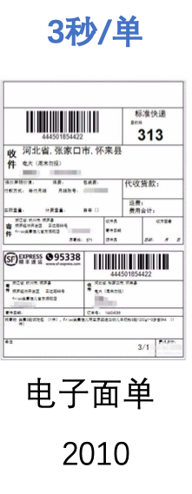
Logistics Network Example: Cainiao
Taobao, Amazon,
Walmart etc.
Customers
identification
30 Billion
2019
150 Billion
2025
Cainiao Smart Logistics Network
Notes:
Now let me explain to you why we need object identification
Take cainiao logistics network as an example. ****The product purchased online have to be delivered as soon as possible through a logistics network to arrive at customers’ hands.
In this scenario, ****we need to identify the package in almost every logistic operation in order to****route it to the destination. ***
Today you can usually see a label like this attached to a package delivered to you, which is for this purpose.
However, the flow of logistics network today is becoming extremely large. For example, the total delivered package number of Cainiao Smart Logistics Network is 30 Billion in 2019 and is expected to be 150 Billion in 2025. To meet the demanding scale and efficiency challenges, we can no longer rely on traditional barcode and QR code which becomes slow, labor intensive and error-prone.

Slide 6

Problem: object identification?
Acclaimed solution: UHF RFID
Notes:
To solve this problem, UHF RFID has been widely acclaimed to be the vital enabler for large-scale efficient, automatic object identification.

Slide 7
UHF RFID
Nearly 30 years development
Only adopted by specific applications
What is the problem?
Notes:
But what we see is that ****although UHF RFID has been there for 30 years and after numerous trials in real-world deployments, ****it only finds its use in very specific application scenarios such as apparel retailers. ****What is the problem?

Slide 8
Accuracy and cost
Cross read package
20 detected
Expected! Great!
20 labeled
packages
Checking zone
19 detected
Miss reading???
21 detected
Cross reading???
?
Notes:
After talking with the vendors and logistics service provider, we found that the main issue of UHF RFID is on the reading accuracy and tag cost. Today we will focus on the accuracy.
****Taking a logistic example, a worker is using trolley to bring 20 labeled packages out of a warehouse. ****The trolley will first pass a checking zone to make sure whether the correct ones are leaving. By using RFID, worker will not need to scan the labels manually. ****The reader in the checking zone can do the detection fast and automatically.
There can be three kinds of reading result, **** first one is all of correct tags are detected which is great. But the life isn’t always perfect.
****Sometimes there will be 19 tags read, which means miss reading happens. ****And sometimes there will be 21 tags, which means cross reading happens --**** the package outside the checking zone has been detected. ****Both results may lead package lost or introduce significant verification cost. This barriers the real RFID deployment.
So let’s look into the reason why these happens.

Slide 9


Miss reading tags
Object attenuates the UHF signal strength a lot!
Object
Liquids like water, drinks
Metal in the package
Reader
Notes:
First the main reason of miss reading is that UHF signal is influenced a lot by objects.
****When the object is between reader and tag, ****the signal strength will be attenuated a lot by the object.
****The Liquids like water, drinks, the Metal in the package
Nearly everything in our daily life will cause attenuation to the RF signal and cause miss reading.

Slide 10
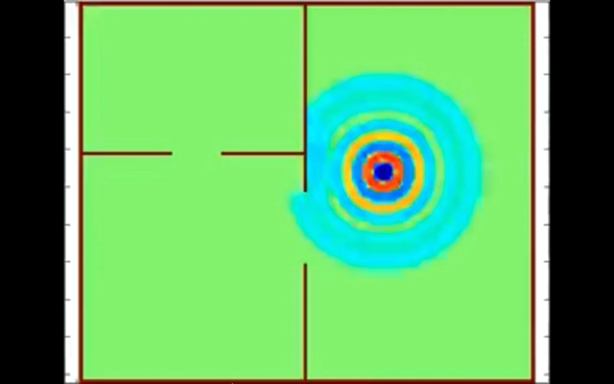
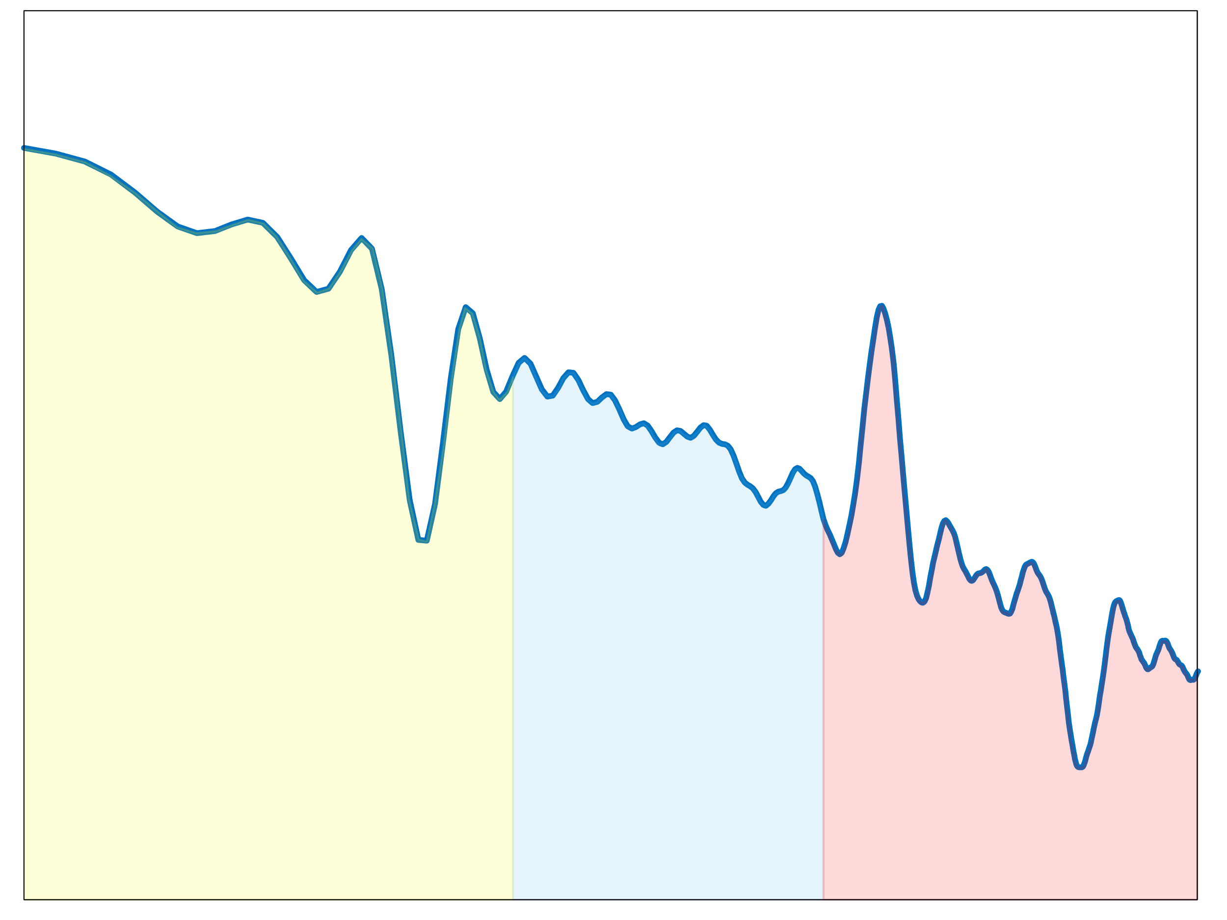
Cross reading tags
Cross reading
⬇
Signal strength
Threshold
Checking zone
Distance
Signal reflection
Signal strength influence
Notes:
Then what is the reason of cross reading. As shown here, **** wireless signal will be reflected by indoor environment. The signal reflected might be combined constructively at some locations.
****As shown in this plot, the signal strength can be pretty large at a long range and results in reading tags ****which is far away from the checking zone.

Slide 11
Billions of lost
→ 99.9%
Accuracy 90%
Tail error matters & hard to reduce
Notes:
Because of the these reasons of miss reading and cross reading, ****we see that the accuracy of UHF RFID is only around 90 percent. We have talked with vendors, logistics service providers and the manufacturers, ****what they expected is an accuracy of higher than 99.9%. ****The 9.9% difference may lead to billions of dollars lost for handling mis-delivered packages. Many vendors even discard the RFID setup after deployment because they do not see any benefit with the low accuracy.
****Therefore, one thing we want to emphasize is that in the real world deployment, the median error or even 90 percent error make no sense. The tail error is the most important issue and hard to reduce.

Slide 12
Properties and Frequency
Microwave
Wavelength
10 km
1 km
100 m
10 m
1 m
10 cm
1 cm
1 mm
Frequency
30 kHz
300 kHz
3 MHz
30 MHz
300 MHz
3 GHz
30 GHz
300 GHz
NFC 13.56 MHz
Magnetic
UHF RFID 915 MHz
Electromagnetic
Notes:
By analyzing the reasons, we found that the main issue is on the physical properties of the signal. Any algorithm base technique will not solve the basic issue introduced by the physical properties ****because it determined by the frequency. Therefore, we choose to change the mind from struggling with the UHF RFID Electromagnetic wave to find some other replacements. ****What we found is that the NFC at 13.56MHz with magnetic wave has much better properties.

Slide 13
Magnetic: Impact of material
Object
Reader
Product | NFC Signal loss | UHF Signal loss
Bottle water | 0 dB | 15 dB
Can coke | 2 dB | 11 dB
Boxed milk | 2 dB | 12 dB
Notes:
Unlike UHF signal, the impact of material to magnetic signal is very small. ****By fixing the location of reader and tag, we can measure the impact by calculating the signal difference**** when the objects is there or not. We picked bottle water, can coke and boxed milk as an example. ****The object influence to NFC signal is much smaller than to UHF signal.

Slide 14
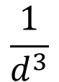

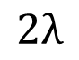
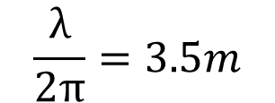
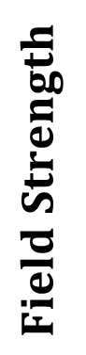
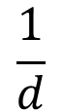
Magnetic: Impact of environment
Magnetic field
No multi-path
no cross reading
$$Field Strength$$
$$\frac{1}{d^{3}}$$
Drop fast
Frequency 13.56 MHz
⬇
Wavelength 22 m
$$\frac{1}{d}$$
Near
field
$$\frac{λ}{2π}=3.5m$$
$$Distance$$
$$2λ$$
Notes:
Then, for the carrier frequency of 13.56 MHz, the wavelength is about 22m. This means that the working zone will be located in the near field region. ****The waveform will be pure magnetic which mean there will be no multipath effect and**** the strength drop much faster comparing to UHF RFID far field signal.
Then NFC reading will be perfectly limited to a range ****and will not meet the cross reading issue.

Slide 15
NFC: Perfect solution versus UHF RFID
Notes:
Because of these properties, it seems that NFC is a perfect solution comparing to UHF RFID. However, it also has its own issues which is the reason why it is not adopted even it has longer history than UHF RFID.

Slide 16
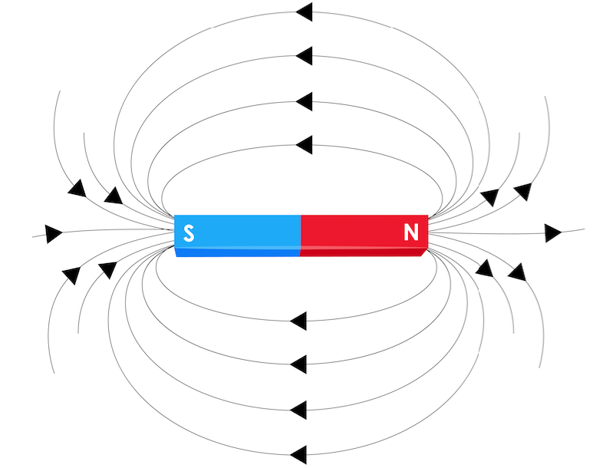
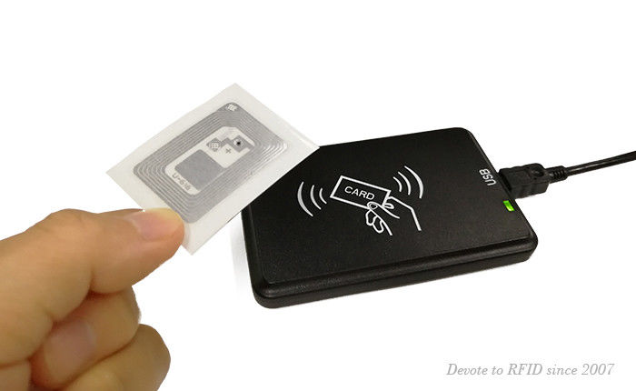
Issues: Range and orientation
tag
Range < 10 cm
Close loop field and orientation
Notes:
The issues of NFC is on the range and orientation. Because the magnetic field attenuates much faster, ****the typical reading range of NFC is really short. For example, the commonly used portable NFC module only covers several centimeters. Even the longest NFC today will only cover 90 cm.
****Then, since the magnetic field is close loop field. The orientation of the tag will influence the strength a lot. For example, ****when the tag is perpendicular to the field, the tag signal is the maximum. ****If the tag is parallel to the field, the tag cannot be read.
Because of these two issues, the NFC technique is mainly limited to proximity applications.

Slide 17
NFC+: range 3m, random orientation,
99.9% accuracy
Notes:
Our NFC+ system solves these two issues. It can boost the range up to 3m and the tags can be random orientation. And the final accuracy can reach the 99.9% requirements.

Slide 18



NFC system: coupling effect
TX coil
Magnetic field
Tag coil
Energy harvester
Coupling
co-eff. $k$
Load
input current $i$
Reader
Tag
Notes:
To understand how we deal with the issues, we need to first introduce the architecture of NFC system.
****NFC system consists of the reader with a TX coil acting as antenna. ****The tag will also have coil with the tag chip.
They are designed following the principles of inductive magnetic coupling. ****As shown here, the reader will generate the magnetic field which is passing through the tag coil. ****The tag and reader will couple with each other.

Slide 19
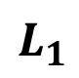
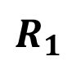
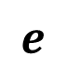

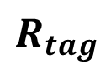
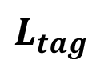
Design principle
Traditional view
Communication view
Range, coil, orientation
$$e$$
$$k$$
+ -
$$R$$
$$R_{1}$$
$$L_{1}$$
$$L_{tag}$$
$$R_{tag}$$
$$a$$
$$d$$
+
-
$$H_{z}$$
Tag
$$I_{L}$$
Reader Coil
Reader coil
Tag coil
Analyze separately
Notes:
Therefore, from the traditional view, the coils of reader and tag will form a loosely coupled transformer. This model can precisely show the behavior of the circuit components. ****But it will also combine all the influence of range, coil parameters and coil orientation into the coupling factor. This barriers solving the range and orientation issues. Therefore, NFC or wireless power transfer usually requires moving the tag to a proper location and orientation to maintain a large enough k.
****Therefore, in our design we are looking in a modern communication view so that we can implement the well developed communication techniques to NFC. Because of the low coupling between reader and tag, we can neglect the tag influence to the reader. ****And then separately analyze the magnetic signal generated by the reader and the magnetic signal received by the tag.
// To understand what parameters we can tune for longer range. We need to first model the system and also see why we still have large room to improve for this kind of old technique.

Slide 20

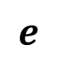


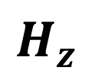
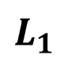


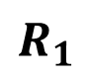

Analyzing procedure
Circuits calculation
Biot-Savart law
Faraday’s law of induction
Reader coil
Reader Coil
$$e$$
$$I_{L}$$
+ -
$$R$$
$$R_{1}$$
$$L_{1}$$
$$a$$
$$d$$
+
-
$$H_{z}$$
$$H_{z}$$
Tag
$$I_{L}$$
(i) Reader circuit
(ii) Range
(iii) Tag orientation
Notes:
More specifically, the analyzing procedure can follow three steps. ****The first step is to calculate the current on the reader coil. ****Then using the calculated current to analyze the generated magnetic field. ****Finally, based on the magnetic field, the signal received by the tag can be calculated based on Faraday’s law of induction.
****Following this analyzing procedure, we can decouple the influence of reader circuit, range and tag orientation and then solve the range and orientation issues independently.
// This step will cover the influence of reader circuits.

Slide 21
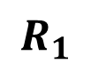

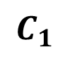

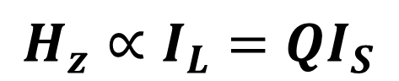



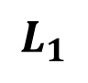

Tech 1: range -- resonance engineering
Quality factor
$$I_{S}$$
$$I_{L}=QI_{S}$$
$$R$$
$$a$$
$$d$$
$$C_{1}$$
$$L_{1}$$
$$R_{1}$$
+
-
$$H_{z}∝I_{L}=QI_{S}$$
$$I_{L}$$
Reader Coil
RLC resonator
Notes:
We will first introduce our first technique on solving range issue which is doing resonance engineering.
Resonating happens at the first stage. ****By adding a shunt capacitor to the reader coil, the circuit will form an RLC resonator. ****The energy stored in the capacitor and inductor will transfer to each other and the current on the coil I_L will be Q times of that from power source. Q here is called quality factor.
****After calculating the magnetic field strength in the second step, ****we can see that the signal strength is proportional to Q. Then a larger Q means longer range.

Slide 22
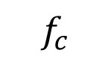
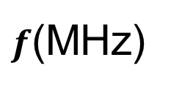



RX suffers
Coil frequency response
Large Q
13.11
$$f_{c}$$
14.01
$f$(MHz)
13.56
$$Tag$$
$$Reader$$
$$Tag$$
Notes:
But too large Q will cause issue to RX. As shown here, the reader will generate signal at a carrier frequency of 13.56 MHz. ****Then the tag will do double side band modulation with a small subcarrier.
When the TX and RX are sharing the same reader coil resonating at 13.56 MHz, ****large Q will suppress the tag signal a lot and reduce the reading range.
// Therefore, the conventional wisdom is that the quality factor 𝑄 should stay low (around 10) to avoid large suppression on the tag signal

Slide 23
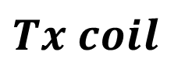
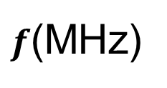
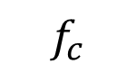
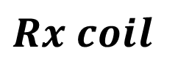
TX/RX separation
Coil frequency response
$$Tx coil$$
$$Rx coil$$
Q improves 20x
13.11
$$f_{c}$$
14.01
$f$(MHz)
13.56
$$Tag$$
$$Reader$$
$$Tag$$
Notes:
But in fact the required bandwidth is**** mainly dominated by the subcarrier. For TX or RX communication, ****the bandwidth is smaller than 100kHz. So there will be a large room for larger Q if we separate the TX and RX coils. **** Let the TX coil resonate at 13.56MHz and RX coil resonate at 14.01 or 13.11 MHz. With this design, ****the Q value can be around 20 times comparing to the current accepted value which boosts the range a lot.

Slide 24
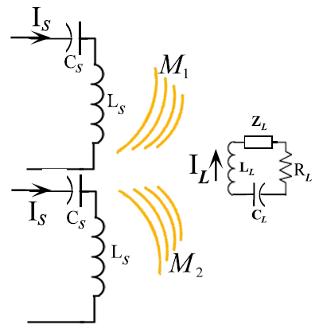
Tech 2 : orientation -- multiple coils
Existing solution in wireless power transfer
Large coupling
Feedback based
Close form calculation
Not appliable
NFC coupling negligible
Feedback is not achievable
TX
RX
TX
MagMIMO MobiCom14’
Notes:
The second technique is using multiple coils to deal with orientation issue.
There has been some work on using multiple coils in wireless power transfer. ****Since the TX and RX are close coupled, the feedback can be measured and can do close form calculation. ****Since the coupling of NFC at a long range is negligible, this feedback based method is not appliable to NFC.

Slide 25
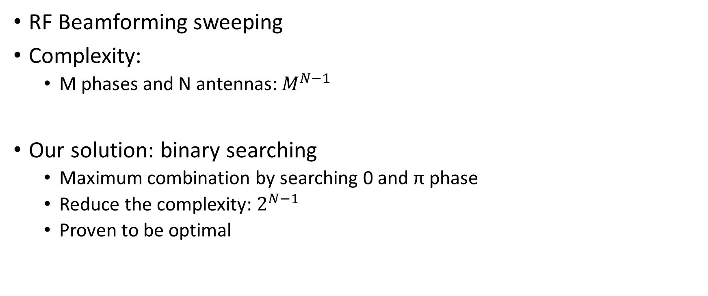
NFC+ magnetic beamforming
RF Beamforming sweeping
Complexity:
M phases and N antennas: $M^{N−1}$
Our solution: binary searching
Maximum combination by searching 0 and π phase
Reduce the complexity: $2^{N−1}$
Proven to be optimal
Tx1
0 0 0 0
Tx2
0 π 0 π
Tag
Tx3
0 0 π π
NFC+ binary search
Notes:
Therefore, ****we need to accept the open-loop scanning method like the RF beamforming sweeping. However, in this method, **** the sweeping complexity is exponentially increased based on the M phase number and the N transmitting antennas, which can be very large and introduce unacceptable time complexity.
****We found that under low coupling scenario, the optimal phase combination between multicoil can be identified by binary searching 0 and π phase. This can reduce the complexity substantially.

Slide 26
Tech 3 Self-interference cancellation
Passive design:
TX-RX separation: narrow band high-Q Coil rejection
Ultra-narrow-band crystal notch filter at 13.56 MHz
Intermedia frequency filtering and digital filtering
Improve RX reading range
TX
RX
Tech 4 Magnetic repeater
$$e$$
+ -
Passive design:
Exited by TX coils
Battery-free
Further improve reading range and reliability
$$H_{z}$$
Rep
Notes:
We have another two techniques which utilize the properties of low frequency magnetic wave.
****One is the passive self interference cancellation design. It contains ****the high-Q Coil rejection introduced by the TX/RX separation, ****the ultra-narrow-band crystal notch filter and ****the filtering at Intermedia frequency and digital domain.
****This technique improves the reading range of RX.
****Another one is the passive magnetic repeater design. The magnetic repeater is exited by the TX coils and does not need other power source such as battery.
This technique can further improve the reading range and the reliability.

Slide 27
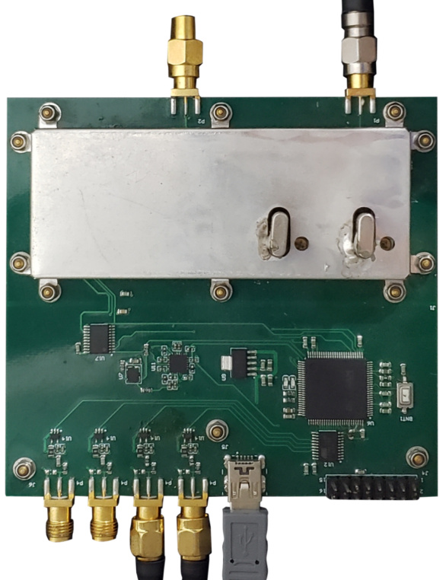
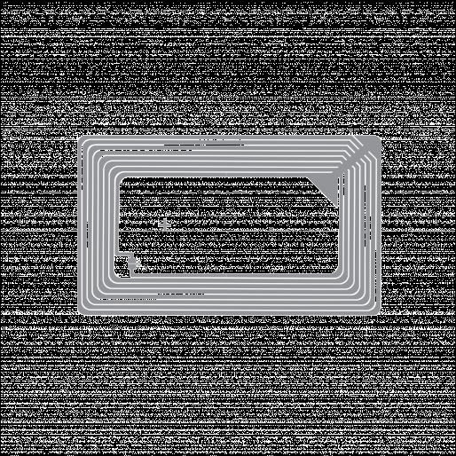
Implementation
From RX coil
Hardware
TX module: multiple chain
RX module: TX to RX interference cancelled
Processor: STM32 ARM Cortex-M7
Coil: 0.9m×1.1m aluminum loop
Tag: Commercial ISO 15693 NFC tag
Software
ISO 15693 protocol in C++
Multiple access
50 tags/s
XTAL self-jamming
cancellation
RX module
Clock and
ARM processor
TX module
To PA and TX coils
Reader
Commercial NFC tag
Notes:
We have built a self designed reader. The hardware design contains a multiple chain TX module, TX to RX interference cancelled RX module and an STM32 ARM processor. The coil of the reader is a 0.9m×1.1m aluminum loop and the tag we used is a commercial ISO15693 NFC tag.
****For the software, we implemented the ISO 15693 compatible protocol in C++ which contains multiple access function. The final reading rate is 50 tags/s.

Slide 28
Range evaluation
RX
3
0
0
300
)
2
5
0
m
c
2
0
0
(
e
c
1
5
0
n
a
1
0
0
90
t
s
i
tag
D
5
0
15
0
1
P
h
o
n
e
P
r
o
x
m
a
r
k
N
F
C
N
F
C
+
3
NFC Reader
m
TX
(
R
D
5
1
0
1
)
Notes:
We will first evaluate the range performance. ****The distance between the tag and NFC readers are changed to find the longest range of commercial readers. ****The smartphone can only read tags around 1 cm away. ****An open source NFC platform Proxmark can read tags at a distance of no more than 15 cm. As a result, they are mainly used as a tool for proximity applications. ****To our knowledge, RD5101 reaches the longest reading range of NFC reader which can read tags up to 90 cm away.
In our NFC+ setup, ****the TX coil and RX coil are placed 3m apart and the tag moves in between. ****By utilizing all the techniques in NFC+, our system can cover the whole range of 3m.

Slide 29
Orientation evaluation
0
-
1
0
RX1
-
2
0
Relative Signal loss (dB)
-
3
0
N
F
C
U
H
-
F
TX1
tag
4
0
RX2
N
F
C
+
-
5
0
0
2
0
4
0
6
0
8
0
1
0
0
1
2
0
1
4
0
1
6
0
1
8
0
TX2
D
e
g
r
e
e
(
°
)
NFC/UHF reader
NFC+
Notes:
We then conduct a simple experiment to illustrate the effectiveness of NFC+’s magnetic beamforming comparing to normal NFC and UHF. ****The tag will be placed in front of reader and rotate by 180 degree. ****The measured signal strength loss is shown here, we can see that both the UHF RFID tag and NFC tag experience more than 30 dB signal strength loss when its antenna is perpendicular (90◦) to the reader antenna.
While in NFC+, ****another pair TX and RX coil are used and the magnetic beamforming is done. ****The results shows that even in the worst case, NFC+ only experiences around 3 dB signal strength degradation.

Slide 30
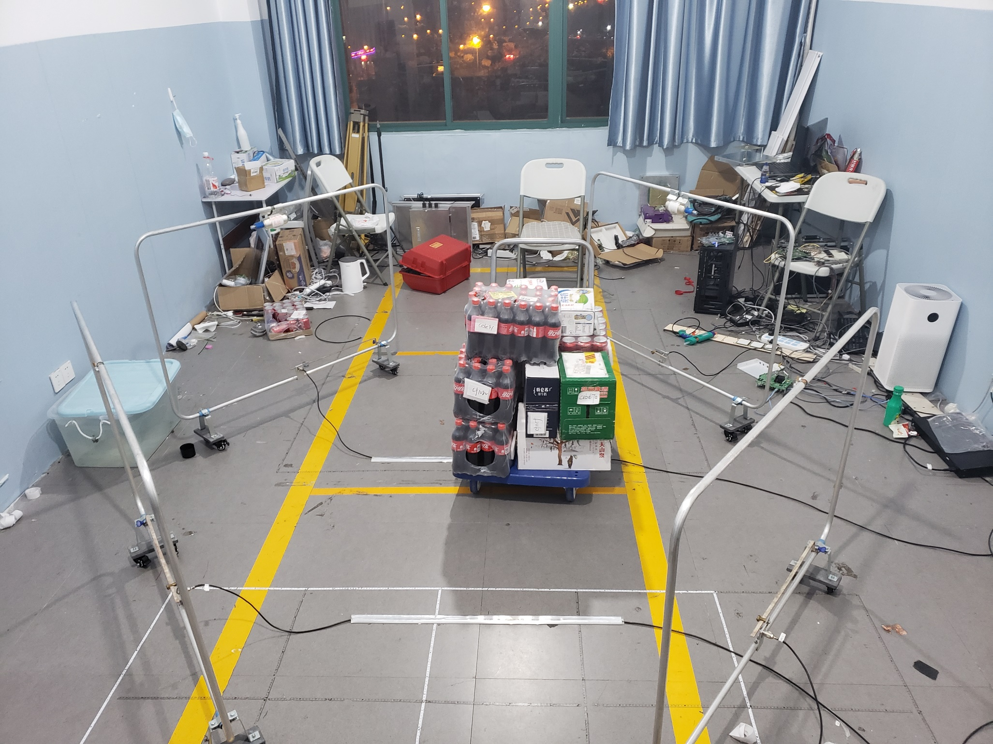
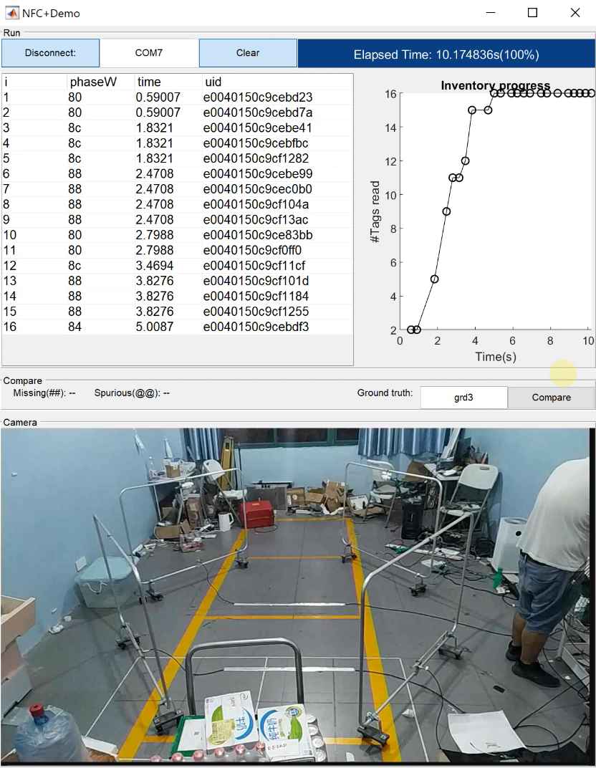
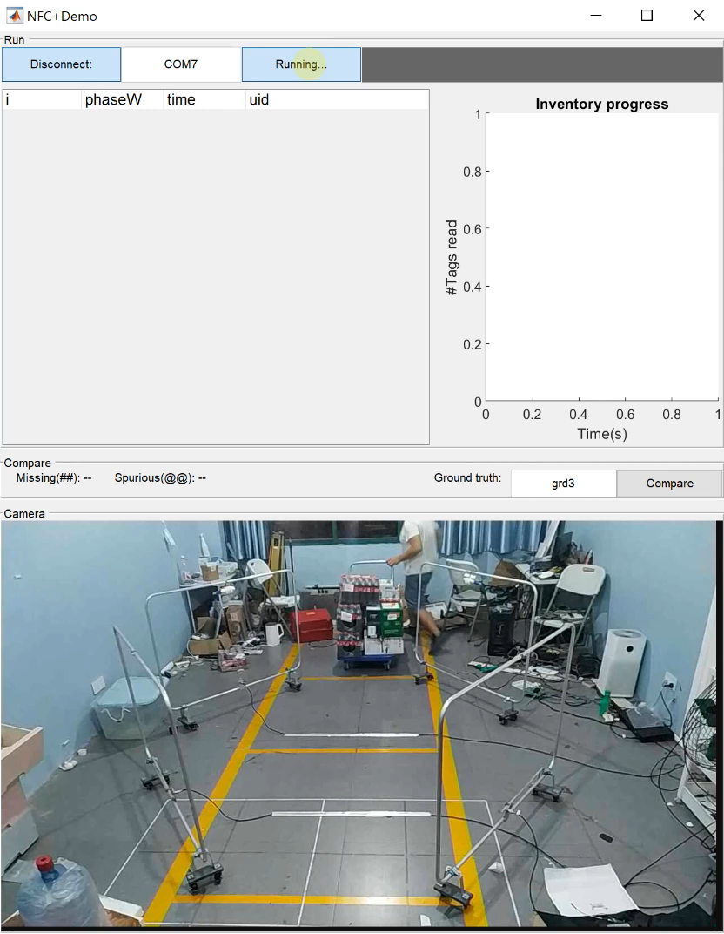
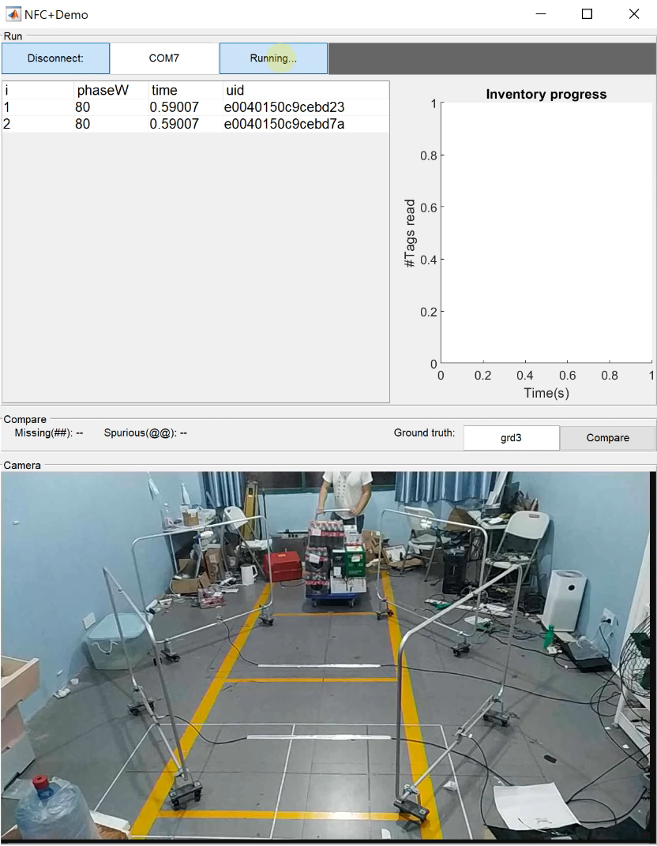
Case study demo
TX coils
NFC tagged
Merchandises
RX coils
Notes:
Here we will show a lab demo simulating the logistic network case. In the region, ****we deployed two TX coils and two RX coils covering a checking zone. ****16 NFC tags are attached to some most RF unfriendly merchandise such as bottle water and coke, can coke and boxed milk. The merchandises are placed on a trolley with random orientation.
****The trolley is pushed through the checking zone and the UID of tags are read.
By comparing with the ground truth, we can get the miss reading number and the cross reading number.
We also did similar evaluations for NFC and UHF system.
?We deployed NFC+ system in the

Slide 31
Case study result
1
0
0
1
0
0
)
)
%
8
%
0
8
(
(
0
e
e
6
0
6
g
g
0
a
a
4
4
2
t
0
t
n
4
n
0
4
e
e
0
2
c
3
c
r
r
e
2
e
0
2
P
P
0
1
.
5
0
4
.
0
3
0
0
0
0
N
F
C
+
N
F
C
U
H
F
U
H
F
N
F
C
+
N
F
C
U
H
F
L
random
orientation
o
S
(a) Miss reading rate
(b) Cross reading rate
Notes:
In the evaluation, we did over 10,000 tags reads to evaluate the tail error performance. We observe that NFC+ will miss only 0.03% of the tags passing through the checking zone. ****Much better than the commercial RD5101 NFC system which misses 40%. When UHF tags are placed on purpose, i.e., all tags have LoS with the reader, ****the UHF RFID system missed 1.54% of the merchandises. When merchandises are placed with random orientation, ****the miss-reading rate of UHF RFID jumps to 23% due to its low reliability under the blockage.
When doing the reading experiment we also place plenty of tags randomly out of the checking zone. ****From the result in the second figure, we can see that neither NFC+ nor the commercial NFC read ANY tag outside. In contrast, ****the UHF RFID experiences a 42% cross-reading rate. The poor cross-reading performance is an inevitable sacrifice when the UHF RFID is tasked to achieve a high reading rate for tags in the checking zone.

Slide 32
Conclusion
NFC+ long range, arbitrary orientation
High accuracy (0 cross reading, 0.03% miss reading)
Take home messages:
Tail error is crucial in real deployment;
Physical property of magnetic field is extremely superior in many applications.
Notes:
In summary, NFC+ is the only system that cover long range with arbitrary tag orientation while achieving over 99.9% accuracy.
We also want to give two take home messages.
One is that the tail error is crucial in real deployment; Researchers also need to keep an eye on this.
The second is that we want to bring magnetic communication back to researchers’ sight because the physical property of magnetic field
is extremely superior in many large-scale applications.
// Finally the NFC+ hardware will be announced on Apsara Conference. Please stay tuned.
// that reads desired tags placed within the checking zone while not reading ANY undesired tags outside.

